Slide 1

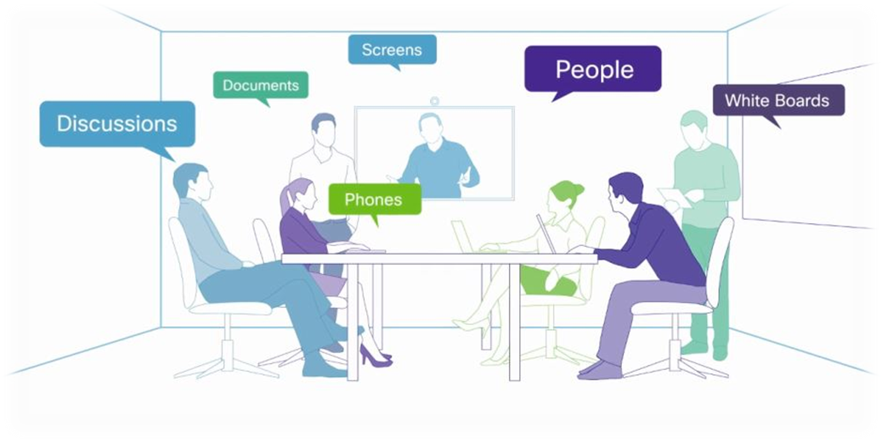



EL Conferencing Services
HOME | BlueJeans | WebEx Meeting
Click for More About BlueJeans Meetings and Support
Or to Schedule a Meeting
Click for More About WebEx Meetings and Support
Or to Schedule a Meeting
For technical assistance, ELDST Support: help@el.nist.gov
301-975-8146

Slide 2


EL Conferencing Services
HOME | BlueJeans | WebEx Meeting
Simple, Immersive, and Video Conferencing * Connect instantly with colleagues and customers from virtually any mobile device, laptop or conference room system. * Screen Sharing and Collaboration * Instantly share your latest presentations, documents and video clips. Share your entire screen or a single application. * Maximum number of participants allowed in a BlueJeans meeting: 100 participants
BlueJeans Request
Meeting Title
Date/Time
Length of Meeting
Your Email Address
SUBMIT REQUEST
BlueJeans Support
Test your system: https://bluejeans.com/111
Joining as a Participant with the BlueJeans App.
Joining as a Participant with a Browser
Sharing content in a meeting.
For technical assistance, ELDST Support: help@el.nist.gov
301-975-8146

Slide 3


HOME | BlueJeans | WebEx Meeting
EL Conferencing Services
* Multiple presenters can share presentations, applications, whiteboards, and streaming video files, and annotate shared content in real time * Audio controls and attention monitoring tools. * Record meeting * Meetings for groups of 1 to 1000 * Moderated by meeting requester * Interactive presentation with video * screen sharing * notes * view participates * chat * People join easily from any platform *
WebEx Request
Meeting Title
Date/Time
Length of Meeting
Your Email Address
Division
SUBMIT REQUEST
WebEx Support
Not sure if your computer has the minimum system requirements? Join a test meeting
Joining a WebEx Meeting on Chrome and Firefox FAQ
Set Up WebEx Meeting Center
WebExMeeting_QuickUserGuide
For technical assistance, ELDST Support: help@el.nist.gov
301-975-8146

